Slide 1
Section 3.8: More Modular Arithmetic and Public-Key Cryptography
Math for Liberal Studies

Slide 2
Modular Multiplication
The modular arithmetic ciphers we have seen use addition and subtraction
For example, the Caesar cipher rule is to add 3 to every letter in the message
What about multiplication?

Slide 3
Modular Multiplication
In an affine cipher, we multiply by a constant number and then add a (possibly different) number
In a multiplicative cipher, we just multiply

Slide 4
Modular Multiplication
For example, let’s encode the message “Attack at daybreak” using an affine cipher where we multiply by 3 and then add 5

Slide 5
Modular Multiplication
For example, let’s encode the message “Attack at daybreak” using an affine cipher where we multiply by 3 and then add 5

Slide 6
Modular Multiplication
To encode T, for example, we convert T to 19, multiply by 3 (to get 57), then add 5 (to get 62). Finally we find the remainder, 10

Slide 7
Modular Multiplication
Now we know how to encode a message using an affine cipher
How do we decode?
Since the 2nd step is to add 5, we should subtract 5 first

Slide 8
Modular Multiplication
How do we undo the “multiply by 3” step?
The natural answer would be to divide by 3, but that’s not really possible in modular arithmetic

Slide 9
Modular Multiplication
There is a way to undo the “multiply by 3” step
It turns out that what we need to do is to multiply by 9

Slide 10
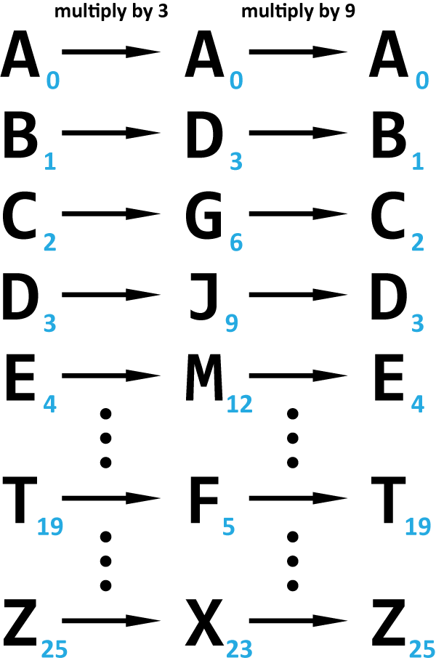
Modular Multiplication
There is a way to undo the “multiply by 3” step
It turns out that what we need to do is to multiply by 9

Slide 11
Modular Multiplication
How does multiplying twice get us back to where we started?
Notice that we’re multiplying by 3 and then by 9
So we’re multiplying by 3 x 9 = 27 = 1
Multiplying by 1 doesn’t change anything

Slide 12
Modular Multiplication
We say that 3 and 9 are multiplicative inverses modulo 26
Also, multiplying by 3 and multiplying by 9 are inverse operations
Finding these inverse operations is key to using multiplication to encode and decode messages

Slide 13
Searching for Inverses
Can any multiplication operation be reversed?
How about multiplication by 6?

Slide 14
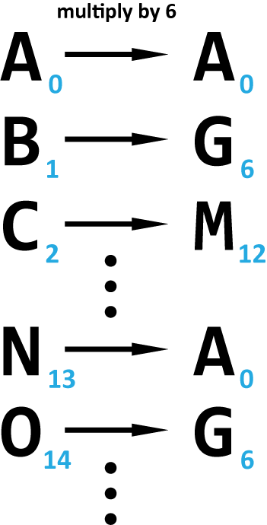
Searching for Inverses
Can any multiplication operation be reversed?
How about multiplication by 6?
As we can see, both B and O get encoded as G

Slide 15
Searching for Inverses
If we wanted to decode a message that has a G in it, there would be no way of knowing if it should be a B or an O
We can’t use this operation to encode messages because it is not reversible

Slide 16
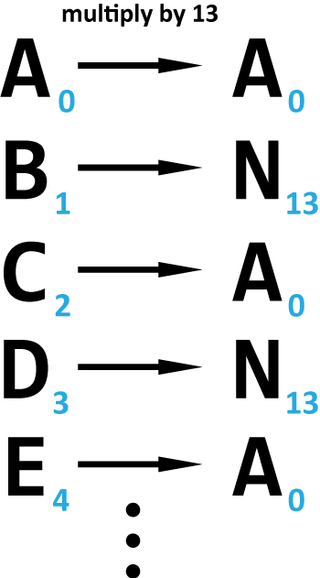
Searching for Inverses
The problem is even worse if we try to multiply by 13
Every letter gets encoded as A or N
It would be impossible to decode a message using this cipher

Slide 17
Searching for Inverses
How can we know in advance whether a particular multiplication operation will be reversible?
Whenever we multiply by a number that shares a common factor greater than 1 with the modulus, that operation will not be reversible

Slide 18
Searching for Inverses
6 and 26 are both divisible by 2
13 and 26 are both divisible by 13
3 and 26 do not share any common factors other than 1

Slide 19
Prime Numbers
For this reason, we will often change the modulus from 26 to a prime number
A prime number only has divisors of 1 and itself
For example, 27 is not prime (its divisors are 1, 3, 9, and 27), but 29 is prime

Slide 20
Prime Numbers
The advantage of using a prime number modulus is that we no longer have to worry about the numbers we multiply by sharing common factors with the modulus
The disadvantage is that our modulus is now greater than 26

Slide 21
Prime Numbers
Suppose we encode the message “Retreat at once” using multiplication by 6, modulo 29

Slide 22
Prime Numbers
Suppose we encode the message “Retreat at once” using multiplication by 6, modulo 29

Slide 23
Prime Numbers
Suppose we encode the message “Retreat at once” using multiplication by 6, modulo 29
Notice that we get results like 26 and 27, which we cannot turn back into letters

Slide 24
Prime Numbers
When we use multiplicative and affine ciphers with a modulus greater than 26, we will simply leave our encoded message as a sequence of numbers

Slide 25
Prime Numbers
We know that using prime numbers means that we will always have a reversible multiplicative cipher
However, in general, finding the inverse operation can be quite difficult

Slide 26
Public-Key Cryptography
Affine and multiplicative ciphers are examples of asymmetric ciphers
This means that the method for decoding messages is not easily determined even if you know the encoding method
Asymmetric ciphers allow for a system called public-key cryptography

Slide 27
Public-Key Cryptography
In a public-key system, everyone has two keys: a method for encoding messages, and a method for decoding messages
With a multiplicative cipher, the keys are numbers:
The encoding key is the number you must multiply by to encode the message
The decoding key is the number used to decode the message

Slide 28
Public-Key Cryptography
The difference in a public-key system is that the encoding keys are made public
Everyone knows everyone else’s encoding key
The decoding keys are kept private
For a system like this to work, it must be very difficult to determine the decoding keys from the encoding keys

Slide 29
Public-Key Cryptography
How does a system like this work?
Suppose Adam wants to send a message to Beth
Adam encodes his message using Beth’s public key

Slide 30
Public-Key Cryptography
Remember that only Beth knows her private decoding key
So only Beth will be able to decode the message
But anyone is able to send a private message like this to Beth

Slide 31
Public-Key Cryptography
Think about it this way: Using Beth’s public key to encode a message is like putting in a special kind of box that only Beth can open
In this case suppose that Beth’s boxes are blue, and only Beth can open blue boxes
But anyone can buy blue boxes, and use them to send messages to her

Slide 32
Public-Key Cryptography
Suppose Adam’s boxes are red
Again, anyone can buy red Adam boxes, but only Adam can open them
If Christine sends Adam a message encoded using his public key, she doesn’t have to worry about Beth intercepting the message and decoding it

Slide 33
Beyond Packages: Signatures
This analogy breaks down a bit, as there is something else we can do with this system
Suppose Christine works at a bank and receives a request to transfer a large amount out of Beth’s bank account
She wants Beth to send a secure message verifying the transfer

Slide 34
Beyond Packages: Signatures
The problem is that anyone can send a message to Christine posing as Beth
Even if they use Christine’s public key to encode the message, this doesn’t ensure that the message came from Beth, it just makes sure that the message goes to Christine

Slide 35
Beyond Packages: Signatures
Instead, Beth can send a message (such as “I authorize the transfer”) to Christine encoded with Beth’s private key
Now anyone can decode this message (using Beth’s public key), but only Beth could have encoded it, since only Beth knows that private key
In this way, it is guaranteed that the message came from Beth

Slide 36
Real-World Cryptography
Notice that affine and multiplicative ciphers are substitution ciphers
This means that they are susceptible to techniques like frequency analysis
These methods are unsuitable to use for public-key cryptography, which requires that the codes be virtually unbreakable

Slide 37
Real-World Cryptography
A common system in use today is RSA cryptography, which relies on the same kinds of ideas we have studied (prime numbers and inverse operations in modular arithmetic)
However, the prime numbers we use for RSA are many digits long

Slide 38
Real-World Cryptography
For example, here is a typical security message used by a web browser
“128 bit” means that the encryption key could be as large as 2¹²⁸, which a 39-digit number

Slide 39
Real-World Cryptography
Even with a computer checking a billion keys per second, it would take up to 10 thousand billion billion years to check them all
This is far, far longer than the age of the universe
RSA relies on the size of the key being large enough to make breaking the code take an impossibly long amount of time

